Slide 1
Music Genre Classification using LSTM
Ml Batch 11:- Team 191
Members:-1)Bharat Chhabil Dave
2)Vinayak Ganpatrao Chavan
3)Rutvik Sunil Bhalekar
4)Ajaykumar Lalchand Gupta

Slide 2
What we have done
Built a Neural Network Model to classify 10 different music genres
The project can divided into 3 parts
Data collection
Preprocessing
Building and training the neural network

Slide 3
Motivation
Why we need music genre classification
A huge amount of music on the Internet
People are more likely to browse or search music by genre
Why choosing this topic
Machine learning is the hotest topic recently
Audio is far less studied than others types of media

Slide 4
Our Dataset
->GTZAN Genre Collection (by George Tzanetakis)
Typically representative of the styles of that genre
 | Duration | Number of Genre | Number of soundtrack | Format
GTZAN data set | 30 Seconds | 10 | 100/genre | 22050Hz Mono 16bit audio file in wave format

Slide 5
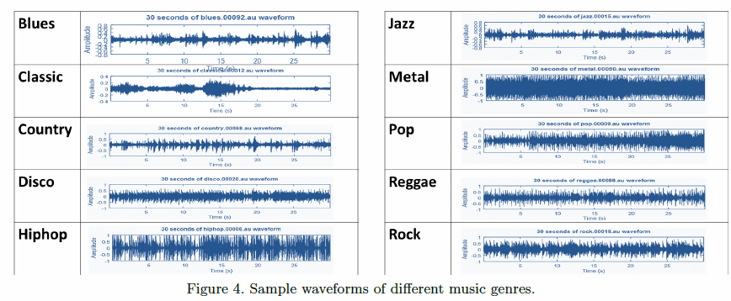
10 different genres

Slide 6
Libraries Used:
[numpy] (https://numpy.org) : Used for
[Librosa](https://librosa.github.io/librosa) : Used for audio feature
extraction
[Keras] (https://keras.io) : Used for creating of LSTM Network.
[Uses Tensor Flow Backend]
3 Layer LSTM:
Layer 1: LSTM LAYER (128 Input)
Layer 2: LSTM LAYER (32 Input)
Layer 3: Dense Layer (Combines Output Into One)

Slide 7
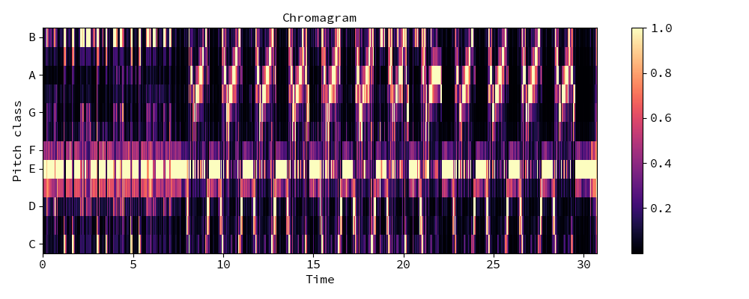
Extracted Features
MFCC:
Represent sound by approximate human auditory system
Chroma
Represent a music audio into 12 distinct semitones of the musical octave

Slide 8
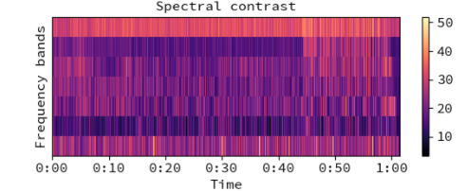
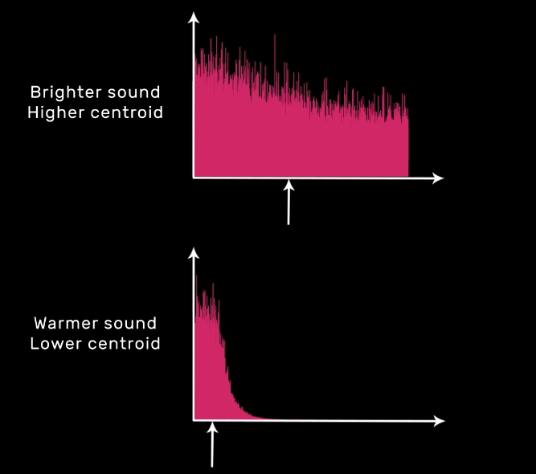
Spectral Contrast:
Represent sound by approximate human auditory system
Spectral Centroid:
Indicates where the centre of mass of the spectrum is located

Slide 9
Conclusion:-
Accuracy at 400 epochs :-
 | Loss | Accuracy
Training | 0.581 | 0.781
Validation | 0.73452 | 0.766666
Testing | 0.9008450 | 0.6833333
Developed a 10 music Genres classification system.
Accuracy is 68% which is comparable to the state-of-that results.

